Slide 1


State Oral Health Improvement Plan
Strategy Indicators:
A Conceptual Framework
Association of State and Territorial Dental Directors (ASTDD)

Slide 2
Figure 1. State Oral Health Improvement Plan Components*
identify and engage
Stakeholders
Systems Approach
Data Utilization
Priority Setting
Objectives, Strategies, Measures
Implementation and Evaluation
Public Communication
disseminate results
establish a planning process
develop and implement a workplan
collect or analyze data
Strategies
develop objectives, strategies, and measures
establish priorities set an agenda
Notes:
*Association of State and Territorial Health Directors. State Health Improvement Plan Guidance and Resources. 2019

Slide 3
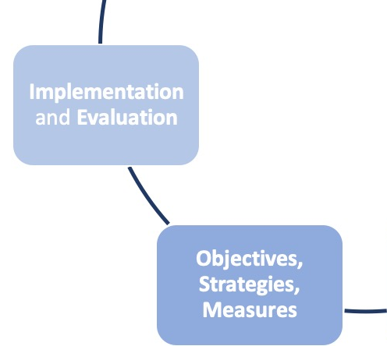
Figure 2. Example Steps: Goals, Objectives, Strategies, Activities
GOAL
OBJECTIVES
STRATEGIES
ACTIVITIES
“To increase the % of children aged 2-3 who have seen a dentist by 2021”
Medicaid Reform
Professional Education
Advocate for reimbursement
Dental CE Courses
“To improve access to child oral health care”

Slide 4
Learning Objectives
To identify predominant SOHIP strategies with example activities
To classify SOHIP strategies into appropriate categories of dental public health core functions and essential public health services
To utilize the updated State Oral Health Plan Comparison Tool

Slide 5
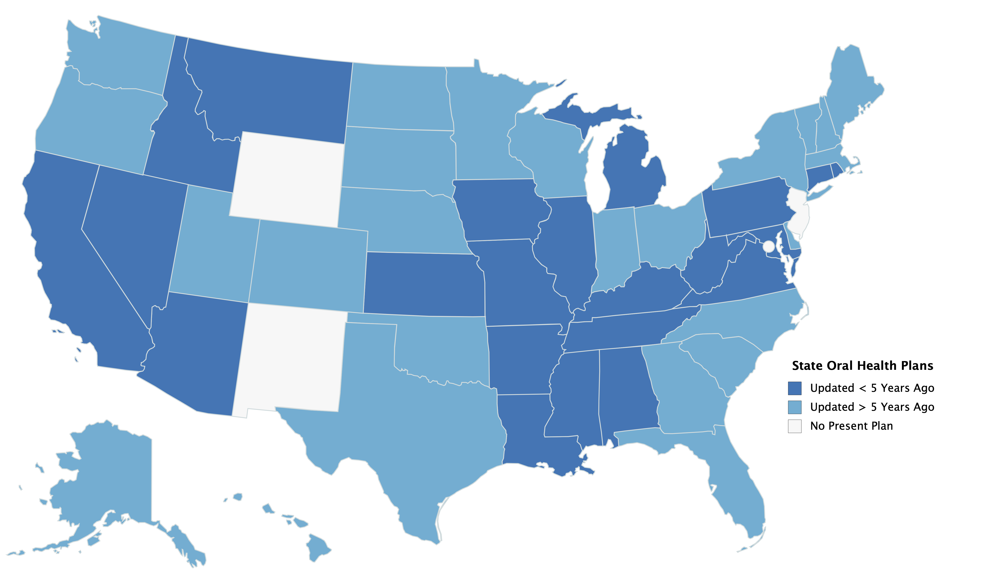
Figure 3. State Oral Health Improvement Plan Timeline of Updates

Slide 6
Background
The process of developing a SOHIP varies widely as does their final content.
This may be attributed to state oral health program
  capacity
  authority
  resources
  composition

Slide 7
Background
State plans do not subscribe to a common set quality measures. Neither:
  structural (e.g., strategies) and
  process (e.g., activities) measures
Uniform quality measures can provide a standard framework to develop a SOHIP, improve quality, monitor progress, or compare with other states.

Slide 8
Background
Purpose
review the most recent SOHIPs,
identify, analyze, describe, organize, and report the most frequent SOHIP strategies (and related activities), and to
categorize strategies into a conceptual framework
  dental public health core function
  dental public health essential service

Slide 9
Methods
Qualitative Content Analysis (QCA)
  NVivo 12 (QSR International Pty Ltd. Version 12, 2018)
Thematic Analysis included identification, interpretation, and categorization of meaningful patterns, or ‘themes’, present throughout the data.
Themes generated an understanding of common strategies used by states to address goals or objectives.
Strategies were identified through an iterative process of…
  data familiarization; data coding; thematic generation, review, labeling and defining.

Slide 10
Results
Of the 50 states and D.C., 47 furnished a State Oral Health Improvement Plan
21 state plans were updated in the past 5 years
23 significant state strategy themes emerged

Slide 11
Results (Plans)
DIFFERENCES
Funding
Time Period
Stakeholder engagement
Evidence
Outcomes
SIMILARITIES
Target populations
Intervention levels and settings
Priorities

Slide 12
Results (Objectives / Strategies / Activities)
OBJECTIVES
  specificity – rather than direct and detailed, were broad or vague;
  measurability – rather than quantifiable, were ambiguous;
  feasibility – rather than practical, were aspirational; or
  timeliness – rather than timebound, were open ended.
STRATEGIES
SOHIP strategies differed according to:
  use, definition, and application along with ensuing activities.
Strategy composition tended to waver between extremes as global - and risked oversimplifying focus - or narrow - and risked missing opportunities.
ACTIVITIES
Plans also varied among activities and implementation, and whether they were scalable, sustainable, or impactful.

Slide 14
Results
Example Narrative (Assessment)
Example Theme: Oral Health Surveillance and Monitoring.
  “The overarching purpose of public health surveillance is to provide actionable health information necessary for public health decision making…”

Slide 15
Results
Example Narrative (Policy)
Example Theme: Medicaid and Managed Care.
  ““dentist participation in the program is limited due to lower reimbursement rates, concerns with non-kept appointments, administrative burdens, and other factors.”

Slide 16
Results
Example Narrative (Assurance)
Example Theme: Medicaid and Managed Care.
  “a shortage of dentists practicing in low-income communities, a shortage of dentists willing to accept public insurance…jobs that do not offer dental insurance, and limited or no transportation services.”

Slide 17
*
*
*

Slide 18
Results
Emerging Oral Health Topics
      Teledentistry
      Opioids
      Dental Therapy
      Oral Health Integration
      Medicaid Waivers - Work Requirement
      State Dental Screening (Mandatory Requirements, i.e. Children)
      Perinatal Medicaid Dental Benefit
      Medicare Adult Benefit
      Student Debt / Loan Forgiveness Programs
      HPV and Oral Health
      Excise Tax - Sugar or Tobacco
      Antimicrobial Resistance in Dental Settings
      Vaping

Slide 21
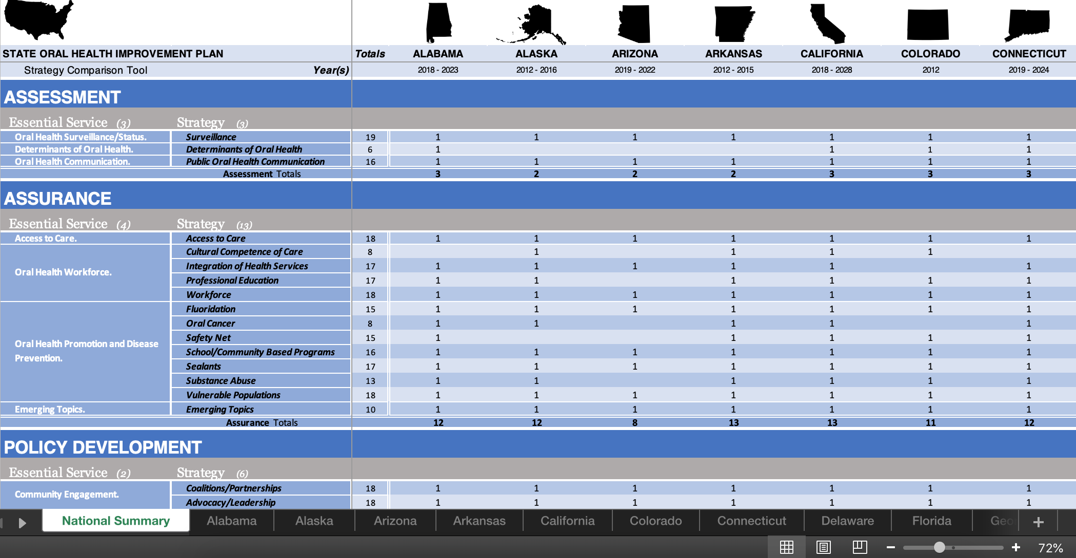

Slide 22
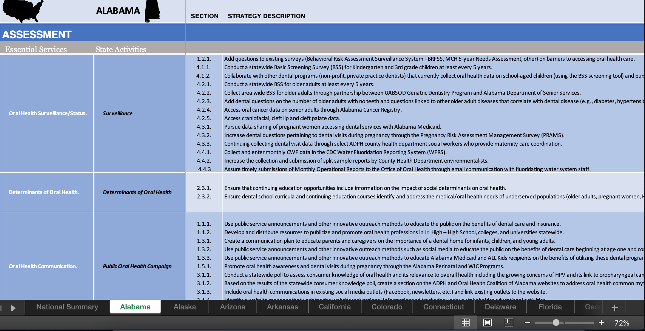

Slide 23
Future Studies
Best Practices Report
Activities Report / Tool
Quality Index Analysis
Cross-State Comparisons Analysis
Developing A State Oral Health Improvement Planning Guidance

Slide 24
Summary
IMPLICATIONS for POLICY & PRACTICE
Strategy indicators can be used for developing state oral health improvement plans, evaluating plan quality, comparing state oral health improvement plans, and for tracking trends over time.
States without strategy indicators can adopt these validated indicators.
There is value in adopting standard measures across state oral health improvement plans, public health organizations, and delivery systems.

Slide 25
Contact

